Slide 1
Persuasion Review

Slide 2
Review - 5 types of persuasion
There are 5 common techniques to persuade someone:
  Bandwagon – “everyone is doing it”
  Loaded words
  Testimonial – “I trust them”
  Transfer
  Repetition

Slide 3
Turn & Talk
Talk with your table – think of AT LEAST one example for AT LEAST one of the persuasion techniques

Slide 4
New persuasion technique - Identity
People also try to convince us of something using our identity by
  Telling all us that people with identities (students, Chicagoans, cool teenagers) think a certain way/use certain products
  Telling us that people’s perceptions of us (the outside of our identity charts) will change if we think a certain way/use certain products

Slide 5
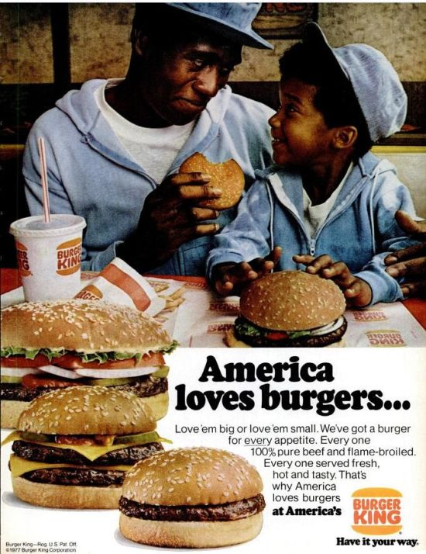
Which identities is this ad appealing to?
  Dads
  Sons
  Americans
  African-Americans

Slide 6

We vs. They
People can use our concern with our community and our desire to exclude others to convince of of an idea

Slide 7

What persuasion techniques is this poster from the 2008 Presidential campaign using?

Slide 8

Obama presidential campaign brochure

Slide 9

World War II poster
Made by U.S. government

Slide 10
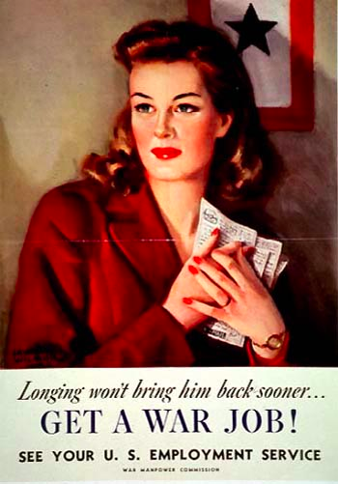
World War II poster
Made by U.S. government

